Slide 1
Reinforcement Learning
An Introduction and Applications

Slide 2
What is Reinforcement Learning?
It is a type of Machine Learning in which an agent learns how to behave in an environment simply by interacting with it and getting rewards (reward can be negative!) from it as a feedback of the actions it takes.
The agent follows a decision process, a policy, and its goal is to take steps for maximizing its future cumulative rewards
Each action taken transitions the environment from one state to the next
The environment state is (partially) visible to the agent
The agent essentially learns by trial and error
The agent needs to find a balance between exploration and exploitation of the environment

Slide 3
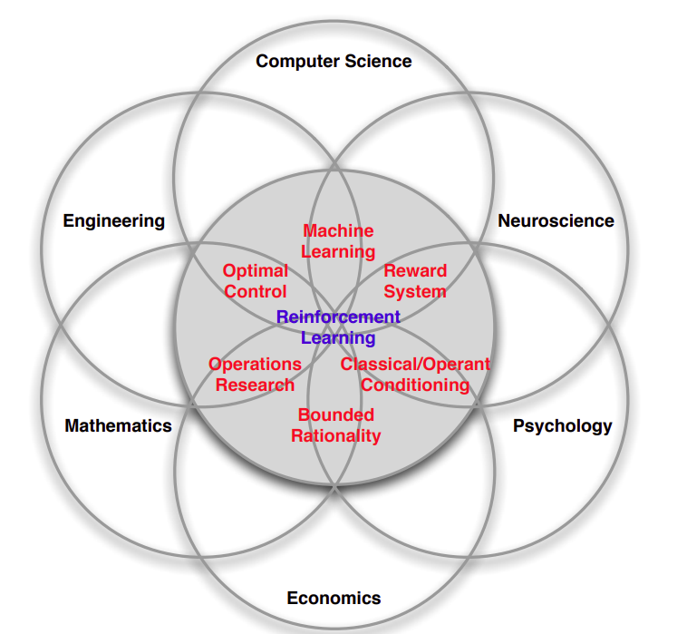
What is Reinforcement Learning?

Slide 4
Example: learning to ride a Bike
Imagine a scenario where a child is learning to ride a bike for the first time.
Environment
The environment in this analogy is the world around the child as they attempt to ride the bike. It includes the road, obstacles, and any other factors that influence the riding experience.
Agent:
The child, in this case, is the agent. They are the entity that interacts with the environment (the bike and its surroundings) and learns from their experiences.
Actions:
The actions in this scenario are the movements and decisions the child makes while riding the bike. These actions include pedaling, steering, and balancing.
Rewards:
Similar to reinforcement learning, the child receives feedback in the form of rewards or consequences for their actions. For example, successfully maintaining balance and riding smoothly could be rewarded with a sense of accomplishment, while falling or losing balance could be seen as negative feedback.

Slide 5
Example: learning to ride a Bike
Imagine a scenario where a child is learning to ride a bike for the first time.
Learning by Trial and Error:
Just as an agent in reinforcement learning learns through trial and error, the child learns to ride the bike through repeated attempts and experiences. Each time they try to ride, they adjust their actions based on the outcomes they observe.
Exploration and Exploitation:
The child must strike a balance between exploration and exploitation. Initially, they explore different strategies for riding the bike, such as adjusting their speed or posture. As they gain experience, they exploit successful strategies more consistently.
Partial Visibility:
The child's understanding of the environment is limited, just as an agent's perception of its environment may be partial. They can only see what is directly in front of them and must rely on their senses and intuition to navigate the environment effectively.
Iterative Learning Process:
Learning to ride a bike is an iterative process, much like training an agent in reinforcement learning. The child continuously refines their skills over time, gradually improving their ability to ride confidently and smoothly.

Slide 6
Definitions
Environment:
The external context or surroundings with which the agent interacts, comprising all elements that influence the agent's behavior and receive actions from the agent.
Agent:
The entity that interacts with the environment, perceives the environment through sensors, takes actions based on its observations, and aims to achieve specific goals or maximize cumulative rewards.
State:
Specific configuration or snapshot of the environment that encapsulates all relevant information needed for decision-making by the agent. It represents the current situation or context in which the agent operates. (Note that environment state and agent observation of the state could be different!)
Actions:
Choices or decisions made by the agent to affect the environment, leading to changes in the state of the environment and influencing future observations and rewards.

Slide 7
Definitions
Rewards:
Feedback or outcomes received by the agent after taking actions in the environment, serving as signals to reinforce or discourage certain behaviors and guiding the agent's learning process. It is a scalar.
Exploration and Exploitation:
The balance between trying new actions or strategies to discover potentially better outcomes (exploration) and favoring known successful actions to maximize immediate rewards (exploitation), crucial for effective learning.
Markov Decision Process:
It provides a mathematical framework for modeling decision making in situations where outcomes are partly random and partly under the control of a decision maker. We will be assuming that the state is Markovian, which means that it contains all useful information from the history: the future (next state and reward) is independent of the past states given the present state.

Slide 8
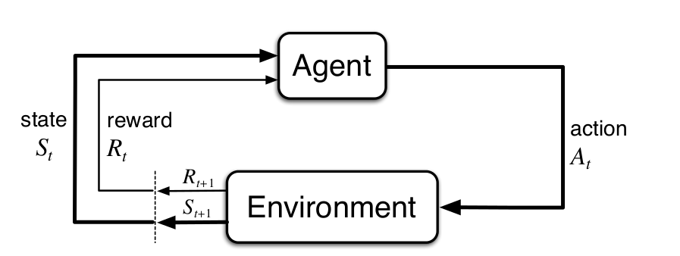
In a nutshell

Slide 9
The Reward Hypothesis
That all of what we mean by goals and purposes can be well thought of as the maximization of the expected value of the cumulative sum of a received scalar signal (called reward).

Slide 10
Applications
Algorithmic Trading:
QuantConnect: A cloud-based algorithmic trading platform that offers tools and infrastructure for developing, backtesting, and deploying trading strategies using reinforcement learning algorithms.
Credit Risk Assessment:
ZestFinance: Provides machine learning-based underwriting solutions for lenders, using reinforcement learning techniques to assess credit risk and make more accurate lending decisions.
Fraud Detection:
Feedzai: Offers a fraud detection platform that utilizes reinforcement learning algorithms to detect and prevent fraudulent transactions in real-time for banks, payment processors, and e-commerce companies.
Large Language Models
ChatGPT : it uses among other techniques Reinforcement Learning With Human Feedback to improve its performance
Games
Atari games, Helicopters, Go,...(trading IS a game too!)

Slide 11
Main Components of RL Agents
Policy:
It is a set of rules which tells the agent what action to take based on the state the agent is now.
It can be deterministic or stochastic
Value Function(s):
Value from a state or state-action pair comes from the accumulation of rewards so far and from what we are going to do now and in the future
If we are in some state and all future states from there are good, then the value of our present state will be high
Model:
It represents the agent's understanding or approximation of the environment dynamics, including state transitions, rewards, and potential outcomes of actions
It enables the agent to simulate and predict the consequences of its actions, facilitating decision-making and learning.

Slide 12
Different Ways of Classifying RL Agent
Model Free
It learns directly from experience without explicitly building a model of the environment's dynamics (i.e., transition probabilities and rewards).
It employs trial-and-error learning methods, to directly learn the optimal policy or value function from sampled experiences.
Model Based
It constructs (or it has been given) an explicit model of the environment's dynamics and uses this model to make predictions and plan actions.
It learns the environment's model from experience or domain knowledge and then use this model to simulate possible trajectories and estimate future outcomes.
You can have a mixed approach too
There are more way to classify agents (value function based, policy based, actor-critic…)

Slide 13
Prediction and Control
There are 2 aspects of RL which are usually discussed in literature: Prediction and Control
Prediction:
Given a fixed policy, evaluate your value function at each state or state action pair
Predicts the future
Policy Evaluation
It is an iterative algorithm that sweeps the state space multiple time until it converges to the actual value function of that specific policy
Control:
Find the best policy
Optimise the future
(Generalized) Policy Iteration
It is a double iterative process, wait for it
This is the GOAL of reinforcement learning!

Slide 14
Control: The Policy Improvement Theorem
Start with Policy p_0, suppose it is a deterministic policy (the theorem works also with a stochastic policy)
So p_0(state1) = action1, p_0(state2) = action2 …
Evaluate the Policy p_0, i.e. find the value function v_[p_0] for each state (it is an iterative algorithm which converges under certain condition to the real v[p_0])
So v[p_0](state1) = value1, v[p_0](state2) = value2…
Get an improved new policy by “greedifying” the existing one, i.e. change the p_0 in one single state and keep following the old policy for all the other states
Change p_0(state1) = action2, so that v[p_0](state1) = new_value > value1
If you cannot find a way to improve the policy this way, then you have found the optimal policy p_* and optimal value function v_*
4. You have now found a new policy p_1 which is better than p_0 (in at least one place)
5. Repeat the process until you cannot improve the policy anymore (in term of convergence) - you have then found the optimal policy p_* and its corresponding optimal value function v_*

Slide 15
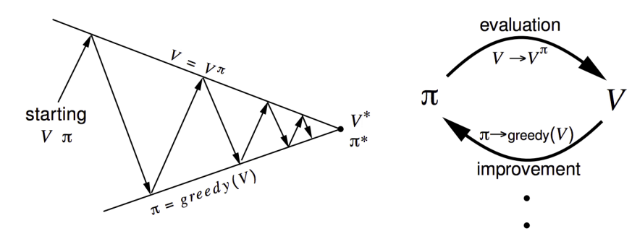
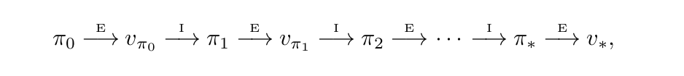
Control: Policy Iteration

Slide 16
Value Function: From Tabular Learning to Function Approximation Learning
In Tabular learning, the state, action, and/or state-action pairs are explicitly enumerated and stored in a table, with each entry containing information such as the expected return or value associated with that state, action, or state-action pair
In some problems, the number of states, or state-action pairs is huge (the game of Go is 10**170+ states, a robot moving around has continuous space state)
Too much memory required for keeping values in a table
Too long to learn accurately the value function of a state/state-action pair
More importantly. there is essentially an issue of generalization.
How can experience with a limited subset of the state space be usefully generalized to produce a good approximation over a much larger subset?

Slide 17
Value Function: From Tabular Learning to Function Approximation Learning
Instead of learning the value function for each state (state-action pair), v(s), we can learn an approximate value instead which can generalize across different states
Compress state space via appropriate features construction
Approximate the value function v(s) with v_approximate(s_features, weights)
As in classical Supervised ML there is a cost function to minimize this approximation against a specific target
Different targets based on the algorithm used, for example Monte Carlo vs SARSA/Q-Learning. But target values in RL are stochastic!
(Stochastic) Gradient Descent for minimizing the cost
2. Many type of function approximation
Linear Combination of Features
Neural Networks
Decision Tree
Nearest Neighbors
Fourier/Wavelet based
…

